Slide 1



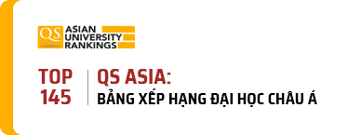



Project Online ticketing system
Software Engineering (CMU-SE 214)
DaNang,12/11/2024

Slide 2


Mentor
Team Project
Msc. Nguyen Trung Thuan
Team member
Tran Minh Nhat
Huynh Nguyen Xuan Huy
Project Title
Cao Thanh Sơn
Team: 1
Tu Hoang Phi Long

Slide 3
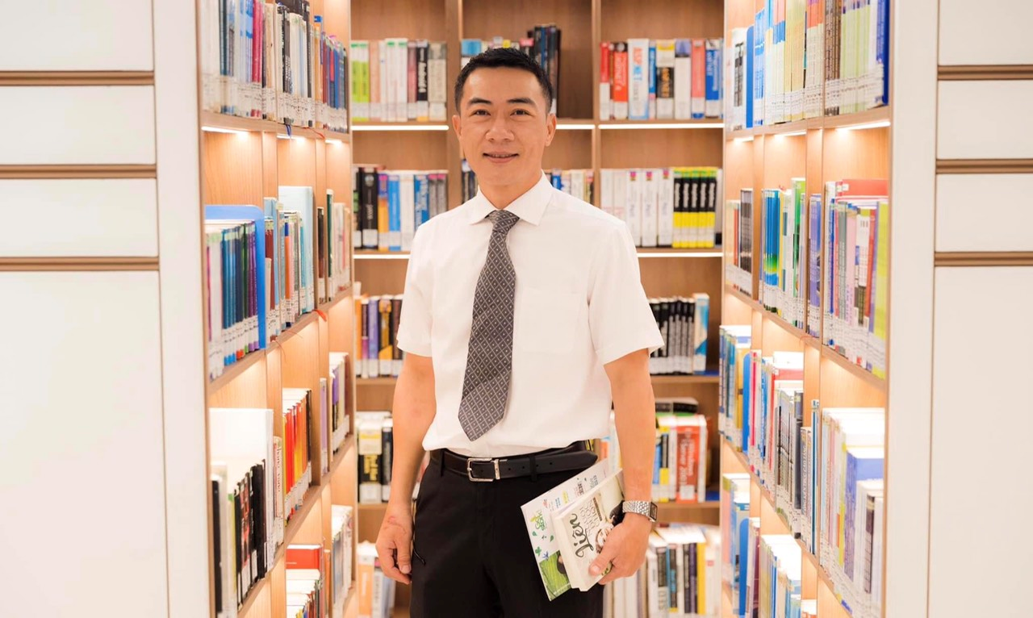
Team Introduction
Tu Hoang Phi Long
Tran Minh Nhat
“Scrum Master”
“Product Owner”
Msc.Nguyen Trung Thuan
“Mentor”
Huynh Nguyen Xuan Huy
Cao Thanh Son
“Member”
“Member”

Slide 4








AGENDA
01
Problem
05
Technologies used
02
Solution
06
Project Management
03
Architecture
07
Reflection
04
Database Design
08
Project Demo

Slide 5
01
Problem
Online ticketing systems often have issues with displaying and managing seats, especially when seat information is not updated in real time or seat maps are difficult to use on mobile. Additionally, during major events, traffic spikes can overload the system, preventing users from completing transactions.
Payments are also a common pain point, with failed transactions or systems that do not support multiple payment methods. The solution is to use real-time update technology, flexible cloud servers, virtual queues, and integration of multiple payment gateways to optimize the user experience.

Slide 6
02
Solution
Friendly Interface: Easy-to-use design, intuitive seat selection support on both desktop and mobile
Payment & Security: Supports multiple payment methods, applies secure transaction encryption and authentication.
Real-Time Technology: Real-time ticket and seat status updates, using cloud servers to avoid overload



Slide 7
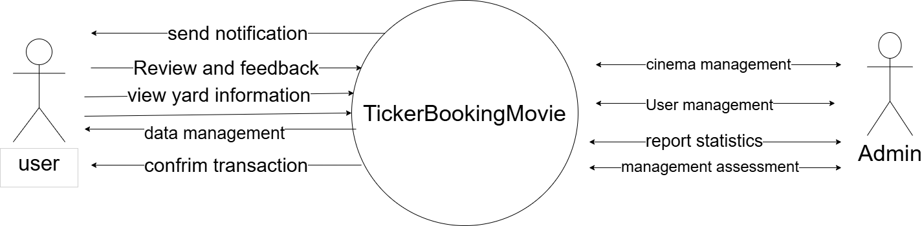
02
System Context Diagram

Slide 8
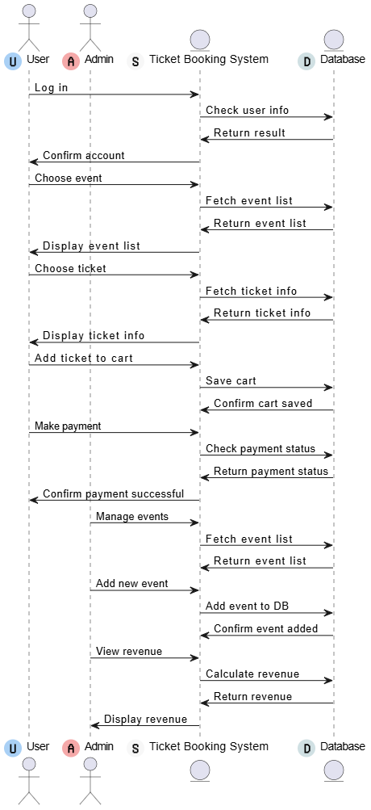
03
Architecture
C&C VIEW Website

Slide 9
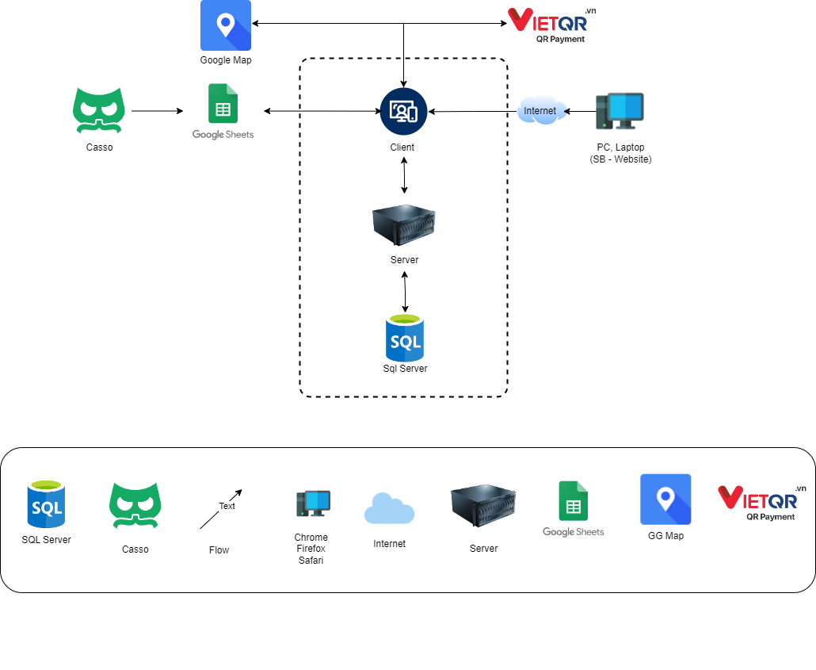
03
Architecture
Allocation View

Slide 10
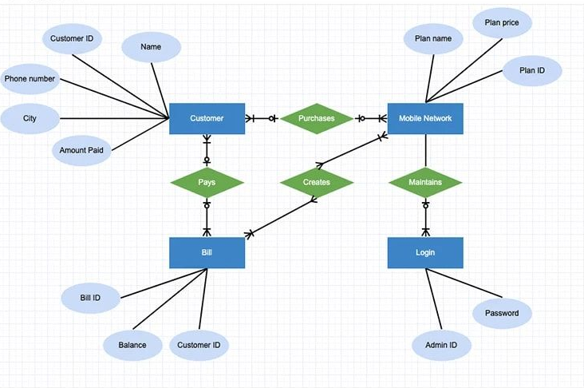
04
Database Design

Slide 11






05
Technologies used

Slide 12
06
Project Management (Treollo)
01
02
03
Sprint 1
Sprint 2
Sprint 3
Start day : 13/10/2024 End day : 02/11/2024 During : 21 days
Start day : 03/11/2024 End day : 23/11/2024 During : 21 days
Start day : 24/11/2024 End day : 12/12/2024 During : 21 days

Slide 13




Tool Used To Manage
Google Drive
Figma
Trello
Github

Slide 14
07
Reflection
The challenges we have to face:
- New technology - Lack of practical experience
- The topic is not yet fully understood professionally and faces many professional difficulties.
The most important thing you learned:
- Teamwork and communication - Process and framework - Problem-solving and accountability
- Teamwork and communication - Process and framework - Problem-solving and accountability

Slide 15
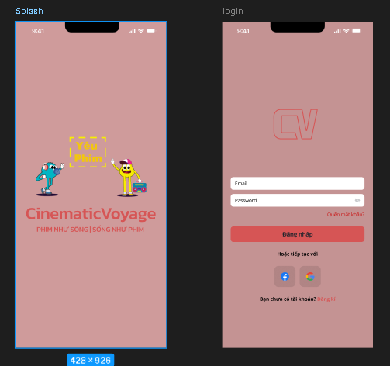
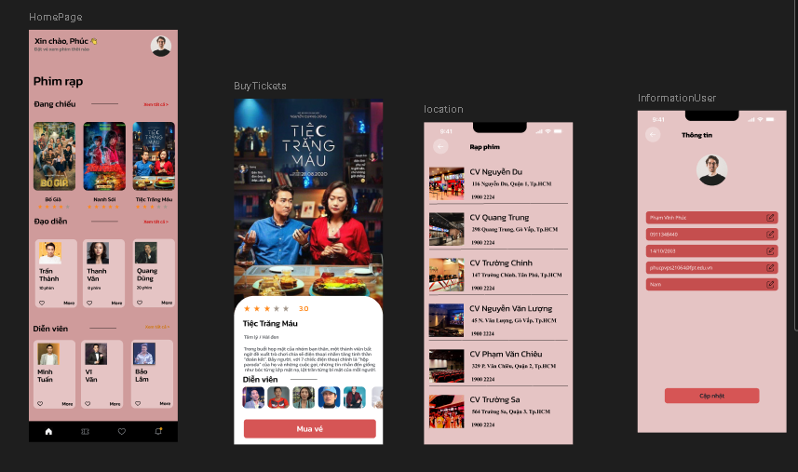
08
Project Demo

Slide 16




